Slide 1
Capstone Engagement
Assessment, Analysis, and Hardening of a Vulnerable System

Slide 2
Table of Contents
This document contains the following sections:
01
Network Topology
02
Red Team: Security Assessment
03
Blue Team: Log Analysis and Attack Characterization
Hardening: Proposed Alarms and Mitigation Strategies
04

Slide 3
Network Topology
‹#›

Slide 4
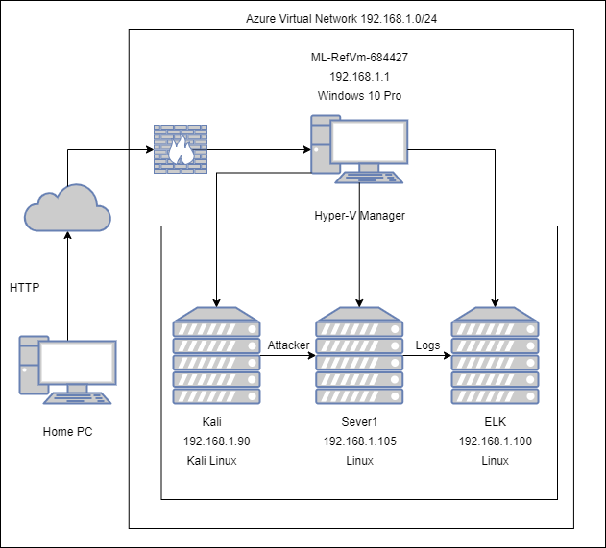
Network Topology
Network
Address Range:192.168.1.0/24
Netmask:255.255.255.0
Gateway:192.168.1.1
Machines
IPv4:192.168.1.1
OS:Windows 10 Pro
Hostname:ML-RefVm-684427
IPv4:192.168.1.90
OS:Kali
Hostname:Kali
IPv4:192.168.1.105
OS:Linux
Hostname:Server1
IPv4:192.168.1.100
OS:Linux
Hostname:ELK

Slide 5

Red Team
Security Assessment
‹#›

Slide 6
Recon: Describing the Target
Nmap identified the following hosts on the network:
Hostname | IP Address | Role on Network
ML-RefVm-684427 | 192.168.1.1 | Host Machine
Server1 | 192.168.1.105 | Vulnerable Web Server
ELK | 192.168.1.100 | SIEM Machine with ELK Stack(Network logs from Server1 and Kali)
Kali | 192.168.1.90 | Attacking machine against Server1

Slide 7
Vulnerability Assessment
The assessment uncovered the following critical vulnerabilities in the target:
Vulnerability | Description | Impact
Use the CVE number if it exists. Otherwise, use the common name. | Describe the vulnerability. | Describe what this vulnerability allows the attacker to do.
Hydra Brute Force CVE-2020-14494 | Brute Force Password | Allows the attacker to find out the password to the Webdav directory.
Remote File Upload | Uploading the PHP File | Allows the attacker to remotely upload a malicious file to the Webdav directory.
PHP Reverse Shell Code Execution | Allow remote shell access | An Attacker is allowed remote access to the host machine.

Slide 8
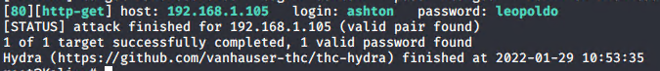
Exploitation: Hydra Brute Force
01
02
Tools & Processes
Ran the username with a wordlist to determine the password. Used the brute forcing tool hydra.
Achievements
I was able to gain the password to the Webdav directory.
03
hydra -l ashton -P /usr/share/wordlists/rockyou.txt -s 80 -f 192.168.1.105 http-get
http://192.168.1.105/company_folders/secret_folder

Slide 9
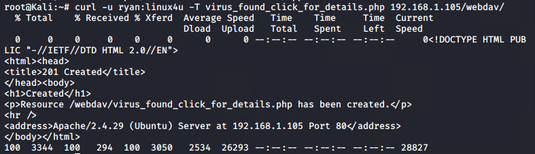
Exploitation: Remote File Upload
01
02
Tools & Processes
Uploaded a malicious file to connect to the server remotely. I used curl with the put command to upload the file.
Achievements
It allows the me to upload a malicious file to the Webdav directory.
03

Slide 10
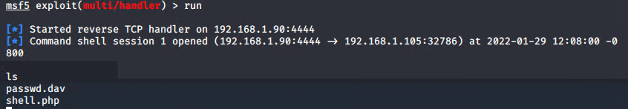
Exploitation: PHP Reverse Shell
01
02
Tools & Processes
Once the target saw the file uploaded they would click the file to investigate the file then would have a remote shell. The tool I used was metasploit with multi/handler.
Achievements
This allowed me remote shell access to the server to run any command I would like.
03

Slide 11

Blue Team
Log Analysis and Attack Characterization
‹#›

Slide 12
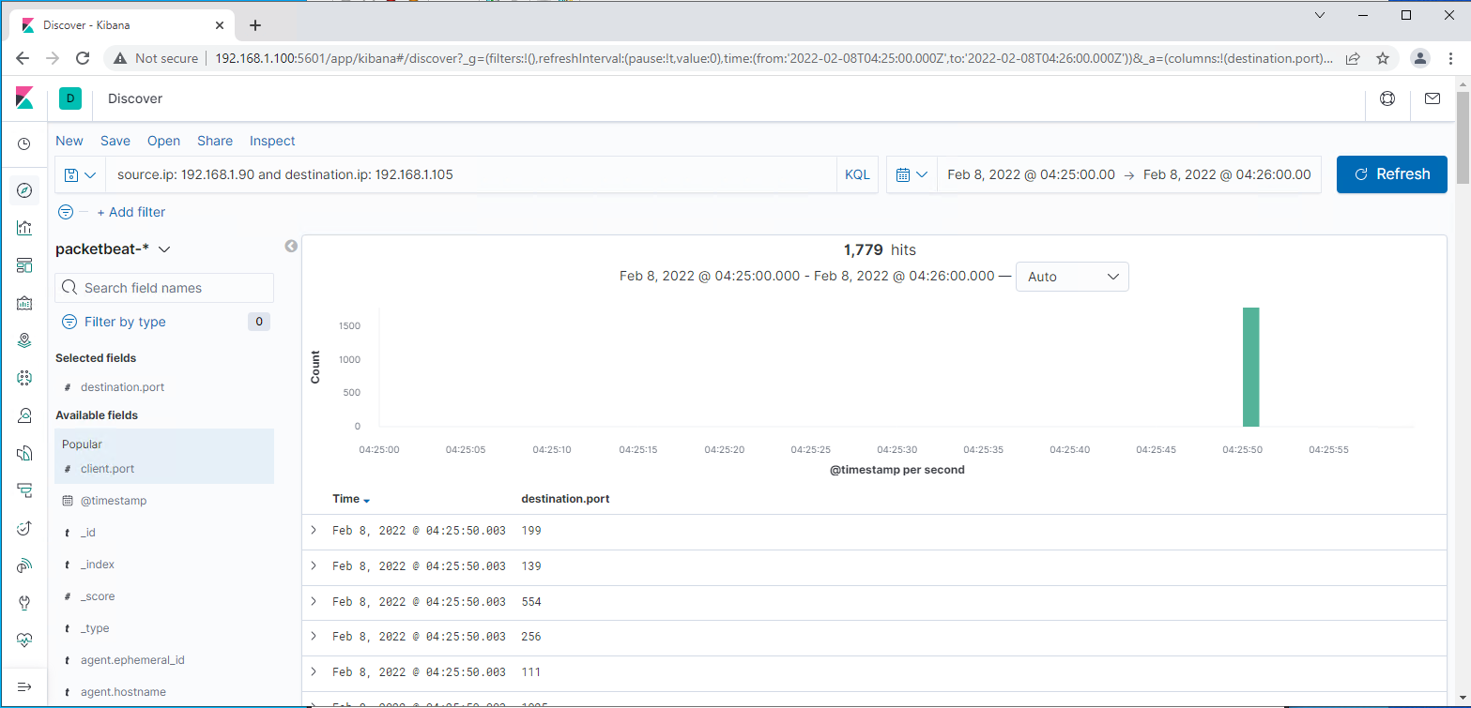
Analysis: Identifying the Port Scan
The port scan occurred on February 8, 2022 at 04:25.
There was 1,779 packets sent from ip address at 192.168.1.90.
What indicates that this was a port scan? There was many different ports scanned within the packet logs.

Slide 13
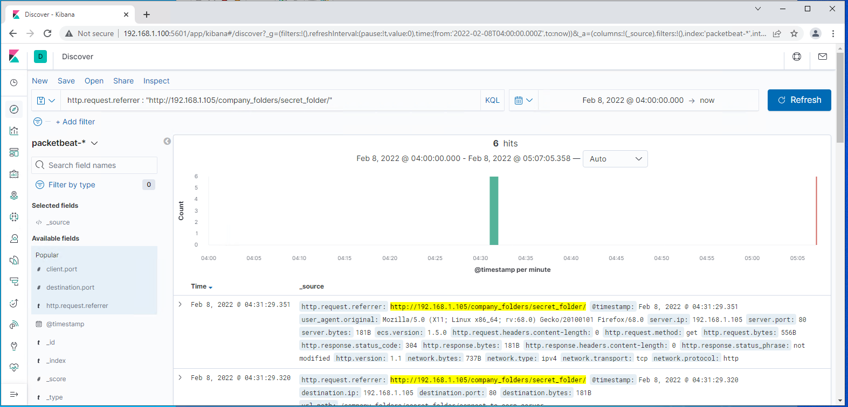
Analysis: Finding the Request for the Hidden Directory
It started at 04:31 on February 8, 2022. There was 6 request made to the hidden directory.
The file that was request was connect_to_corp_server. The file contains information to log in to the remote server.

Slide 14
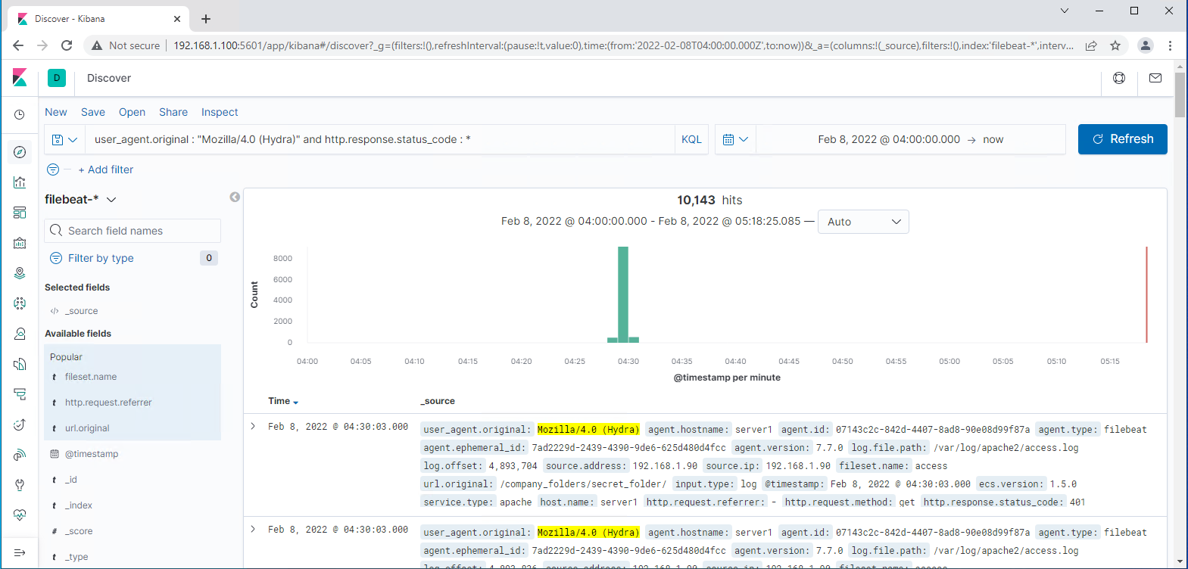
Analysis: Uncovering the Brute Force Attack
There was 10,143 attempts made by hydra.
There was 10,142 attempts made by hydra before the password was discovered.

Slide 15
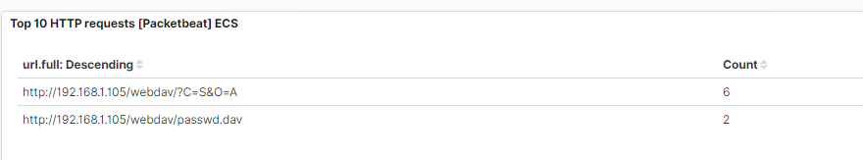
Analysis: Finding the WebDAV Connection
There was 8 requests made to the Webdav directory.
The main folder and the passwd.dav files were requested.

Slide 16
Blue Team
Proposed Alarms and Mitigation Strategies
‹#›

Slide 17
Mitigation: Blocking the Port Scan
What kind of alarm can be set to detect future port scans?
Send an email if more than 5 ports get scanned in an hour from any IP.
What threshold would you set to activate this alarm? The threshold should be set at anything greater than 5 ports scanned.
What configurations can be set on the host to mitigate port scans?
Block all port scans
Describe the solution. If possible, provide required command lines.
Configure the firewall to block all port scans.

Slide 18
Mitigation: Finding the Request for the Hidden Directory
What kind of alarm can be set to detect future unauthorized access?
Send an email that a user has accessed the hidden directory from an unknown IP that is not whitelisted.
What threshold would you set to activate this alarm?
The threshold would be set to anything greater than 0.
What configuration can be set on the host to block unwanted access?
Password must contain special characters, numbers, and capital letters.
Describe the solution. If possible, provide required command lines.
Use strong passwords for administrators and remove any mention of the directory from public facing files.

Slide 19
Mitigation: Preventing Brute Force Attacks
What kind of alarm can be set to detect future brute force attacks?
Send an email if multiple failed login happens with in a hour.
What threshold would you set to activate this alarm?
The threshold for the alarm would be set at any number greater than 5 failed attempts.
What configuration can be set on the host to block brute force attacks?
Configure user accounts to lock after several failed attempts.
Describe the solution. If possible, provide the required command line(s).
Lock the account if the failed attempts excessed 5.

Slide 20
Mitigation: Detecting the WebDAV Connection
What kind of alarm can be set to detect future access to this directory?
Send an email that a user has accessed the Webdav directory from an unknown IP that is not whitelisted.
What threshold would you set to activate this alarm?
The threshold would be anything greater than 5 in an hour.
What configuration can be set on the host to control access?
Require MFA for access to the directory.
Describe the solution. If possible, provide the required command line(s).
Using MFA would make it so you have to confirm your user rights from outside sources.

Slide 21
Mitigation: Identifying Reverse Shell Uploads
What kind of alarm can be set to detect future file uploads?
Send an email that there was an upload to the Webdav directory.
What threshold would you set to activate this alarm?
The threshold should be set to anything greater than 0.
What configuration can be set on the host to block file uploads?
Firewall configure to only allow uploads from whitelisted IP addresses.
Describe the solution. If possible, provide the required command line.
This would only allow authorized users to upload to the Webdav directory.

